Slide 1
ML Model Registry - How?
Pravin Y Pawar
Adapted from ML Model Registry
By Stephen Oladele

Slide 2
Where does a model registry fit in the MLOps stack?
If want to run machine learning projects efficiently and at scale,
most likely need to add a model registry to MLOps stack.
Depending on what level of implementation you are in your MLOps stack,
needs and requirements for a model registry would differ.
Where does it fit?
the model registry sits between machine learning development and deployment.

Slide 3
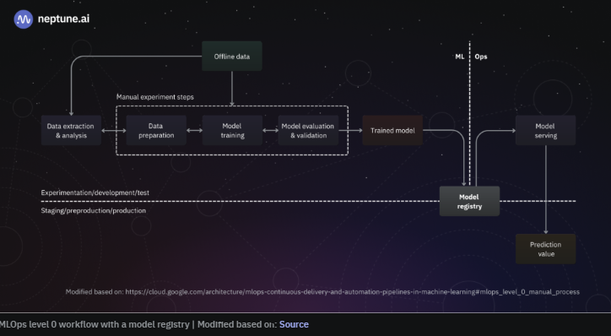
Where does a model registry fit in the MLOps stack?(2)
Model registry in MLOps level 0
The output from the experimentation step is fed into the model registry.
involves a manual process where the data scientist prepares the model artifact and metadata and could also package them (serialization,
containerization) before registering them
The operations team can push the packaged model to the staging environment
for testing before deploying it to a prediction service engine that can integrate with other applications.

Slide 4
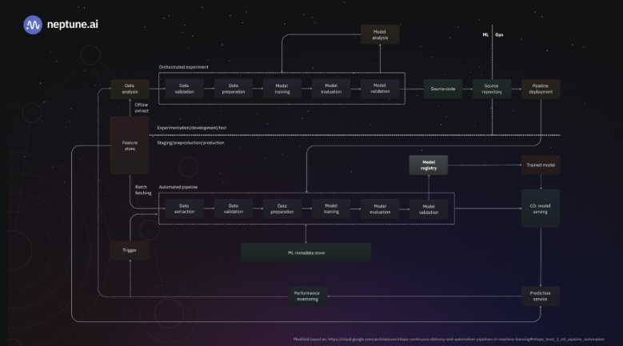
Where does a model registry fit in the MLOps stack? (3)
Model registry in MLOps level 1
As opposed to level 0 (where the workflow
is a manual process), the goal of the
workflow in level 1 is to perform continuous
training of the model by automating the ML
pipeline. This is one process a model registry
enables well because of its ability to integrate
with the pipeline.
At this level, the entire pipeline is
deployed, and when models are trained
on the provided dataset, the output
(trained model and metadata) is fed into the
model registry where it can be staged, and if it
passes the necessary tests and checks, it can
be fed to the continuous delivery pipeline for
release.

Slide 5
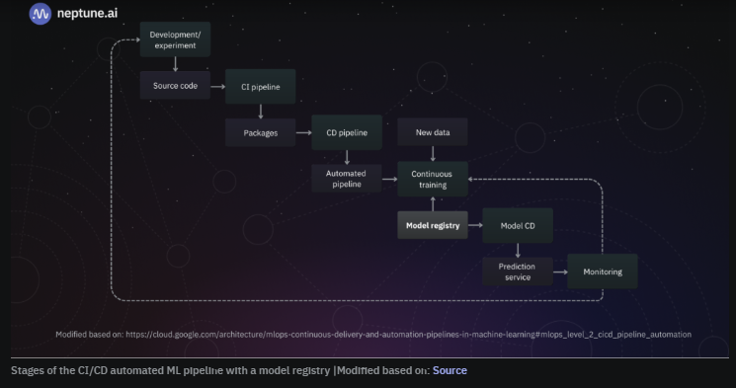
Where does a model registry fit in the MLOps stack?(4)
Model registry in MLOps level 2
The role of the model registry in level 2 of the MLOps workflow is also the same as that of level 1—the automated pipeline delivers the trained model to the model registry where it is staged, may be passed through QA checks, and sent to the continuous delivery pipeline:
The model registry serves as a crucial component in any automated pipeline because event triggers can be integrated with it to promote models with good metrics upon re-training on fresh data or archive models.

Slide 6
Setting up ML model registry – build, maintain or buy?
Setting up a model registry for MLOps workflow will require you to decide on either
Building one,
Maintaining one,
or Buying one

Slide 7
Setting up ML model registry – build, maintain or buy?(2)
Building a model registry solution
Like any software solution, if you understand the key functionalities and requirements, you can build a
system yourself! This is the case with a model registry.
May want to set up the following:
Object storage for models and artifacts
Database for logging model details
API integration for both receiving models, promoting models across various environments, and collecting
model information from the different environments
User interface (UI) for ML teams to interact with a visual workflow
While building the solution yourself might seem ideal, you should consider the following factors:
Incentive: What’s the incentive to build out your solution? Is it for customization or for owning a proprietary license to the solution?
Human resources: Do you have the talents and skills to build out your solution?
Time: How long would it take you to build out a solution and is it worth the wait?
Operations: When the solution is eventually built out, who would maintain its operations?
Cost: What would it cost you to build a solution, including the maintenance of the solution?

Slide 8
Setting up ML model registry – build, maintain or buy?(3)
Maintaining a self-hosted model registry
Another option to consider is to maintain an existing solution yourself
solution has been built out already, but might have to manage some features, such as object storage and database
most of these existing solutions are open-source solutions
The following are the factors to consider:
Type of solution: Are you going to opt for an open-source solution with no license cost or a closed-source solution
with license cost?
Operations: Who is going to manage the solution? Does the solution support consistent maintenance and
software updates?
Cost: What is the cost of operating the solution in terms of the infrastructure to host it and the running cost?
Features: What features have already been implemented, and what features do you have to build and manage
yourself? Is it worth adopting compared to building out your solution?
Support: What type of support is available in case things break during operations? Is there a community or
dedicated customer support channel? For open-source solutions, while you might have a community, you will likely lack the necessary developer support required to fix things.
Accessibility: How easy is it to get started with the solution? Is the documentation comprehensive enough? Can everyone
from the model reviewers to the model developers and software engineers intuitively use the solution?

Slide 9
Setting up ML model registry – build, maintain or buy?(4)
Purchase the license to a fully-managed solution
The final option to consider is subscribing to a fully managed solution where the operations and management of
the registry are handled by the solution vendor
do not have to worry about building or maintaining a solution
just have to ensure systems and services can integrate with the registry
Here are the factors to consider:
Industry type: What type of industry is the model built for? What sensitive information have the models learned?
Are there data privacy compliance measures? Is the model only allowed to stay on-premise?
Features: Are the key features and functionalities of any model registry available in this solution? What extra features are
available, and how relevant are they to your workflow?
Cost: What’s the cost of purchasing a license, and do the features justify the cost?
Security: How secure is the platform hosting the solution? Is it resistant to third-party attacks?
Performance: Is the registry highly performant? For situations where models are too large, can the registry provide models for
services to consume at low latency?
Availability: What’s the uptime of the solution, and does it meet your required service level agreement (SLA)?
Support: What level of support is available in case things go south?
Accessibility: How easy is it to get started with the solution? Are the documentation and learning support decent enough?
What’s the learning curve in terms of usage?

Slide 10
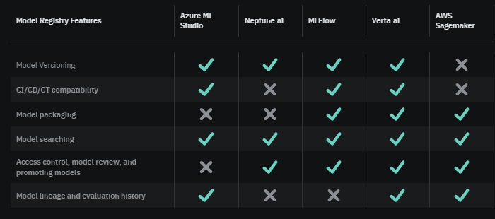
ML model registry solutions out there
The most popular ones available out there that offer a host of Model Registry features.

Slide 11
Thank You!
In our next session:

